Slide 1

CUAI 스터디 핸즈온 3팀
2022.05.17
발표자 : 유상준

Slide 2
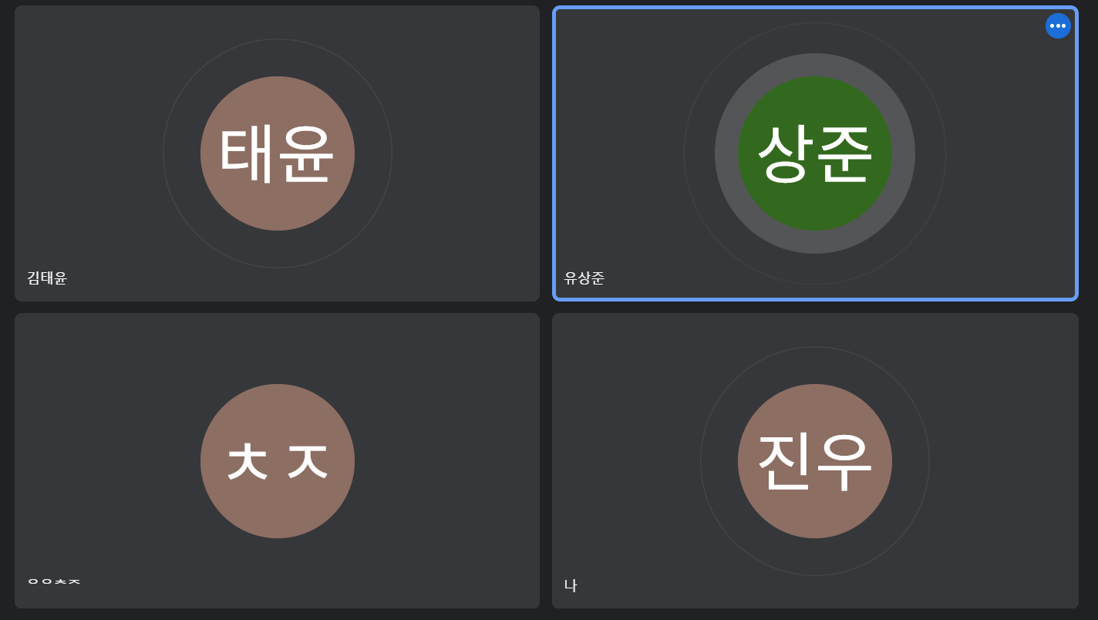
스터디원 소개 및 만남 인증
스터디원 1 : 김태윤
스터디원 2 : 오창준
스터디원 3 : 유상준
스터디원 4 : 김진우
매주 목요일 저녁
정문카페 or zoom

Slide 3
목차
1. Ensemble learning
2. Random forest
3. AdaBoost & Gradient Boosting
4. Stacking

Slide 4
참고자료 : StatQuest with Josh Starmer 의 StatQuest: AdaBoost 영상
https://dailyheumsi.tistory.com/115?category=877153
https://bkshin.tistory.com/entry/%EB%A8%B8%EC%8B%A0%EB%9F%AC%EB%8B%9D-11-%EC%95%99%EC%83%81%EB%B8%94-%ED%95%99%EC%8A%B5-Ensemble-Learning-%EB%B0%B0%EA%B9%85Bagging%EA%B3%BC-%EB%B6%80%EC%8A%A4%ED%8C%85Boosting
https://hwi-doc.tistory.com/entry/%EC%8A%A4%ED%83%9C%ED%82%B9Stacking-%EC%99%84%EB%B2%BD-%EC%A0%95%EB%A6%AC

Slide 5
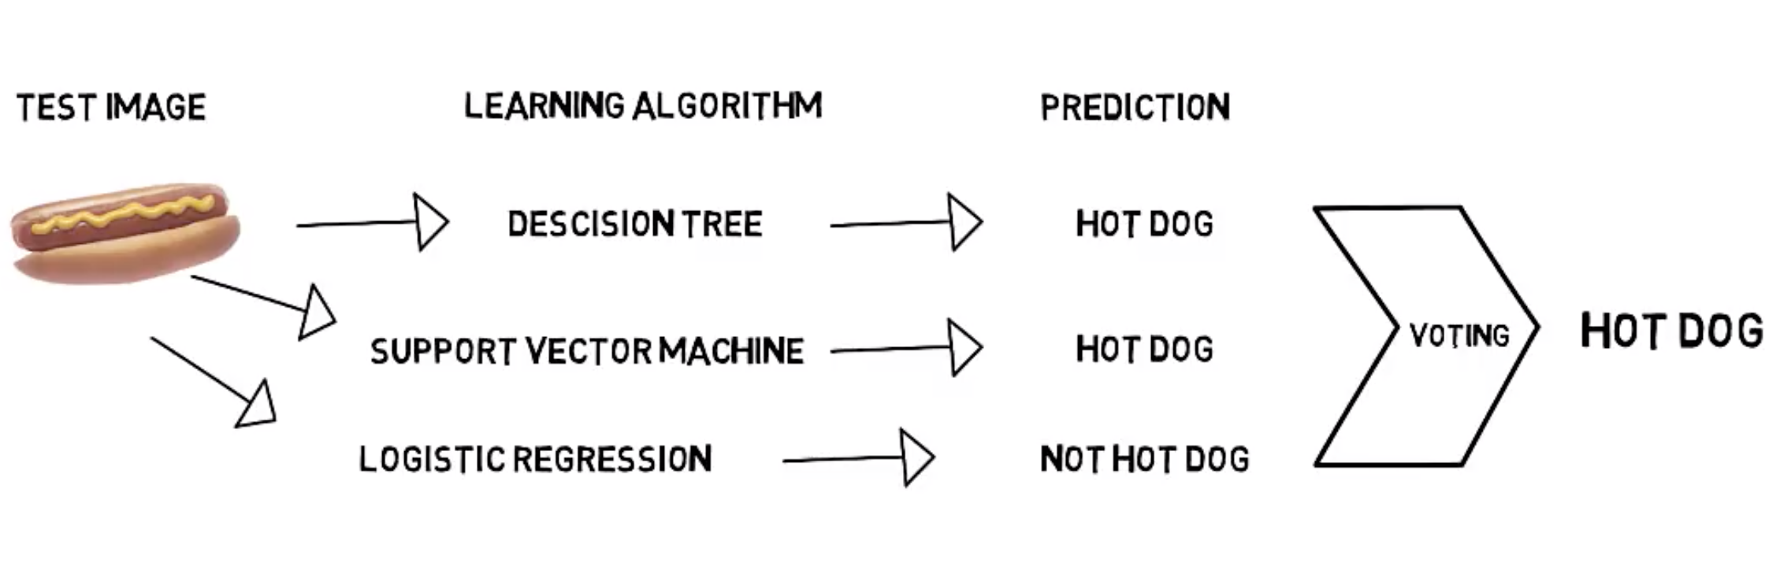
What is Ensemble learning?

Slide 6
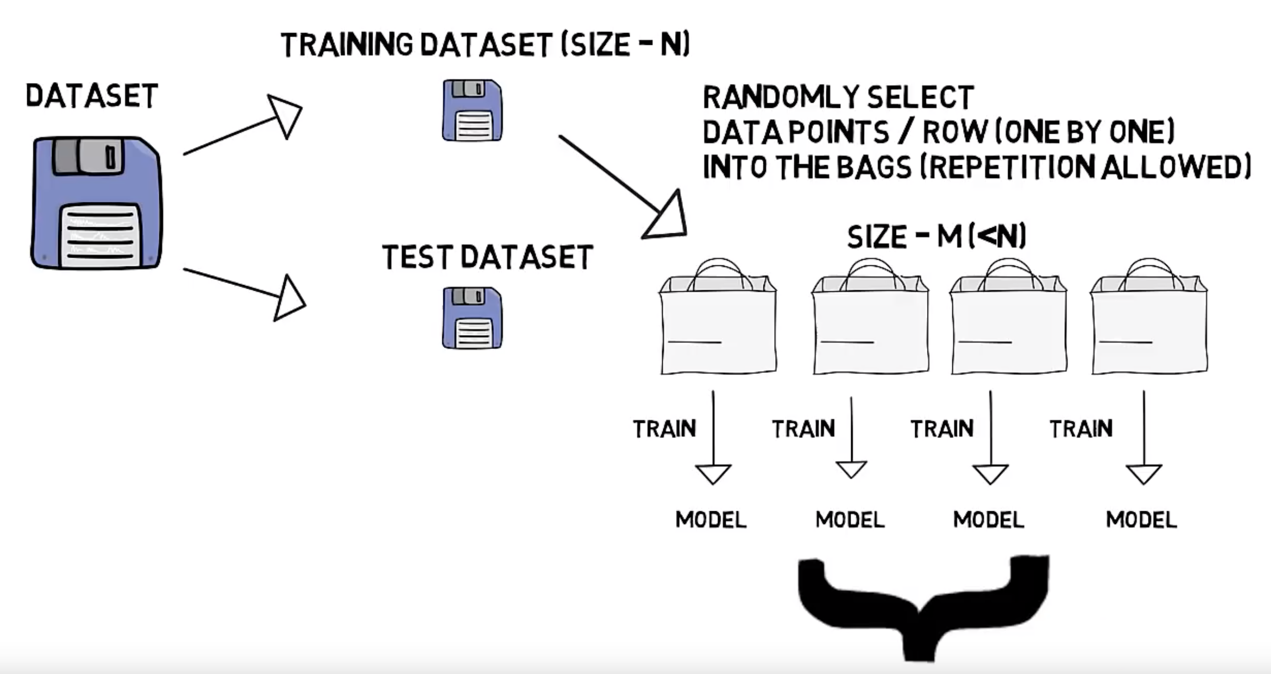
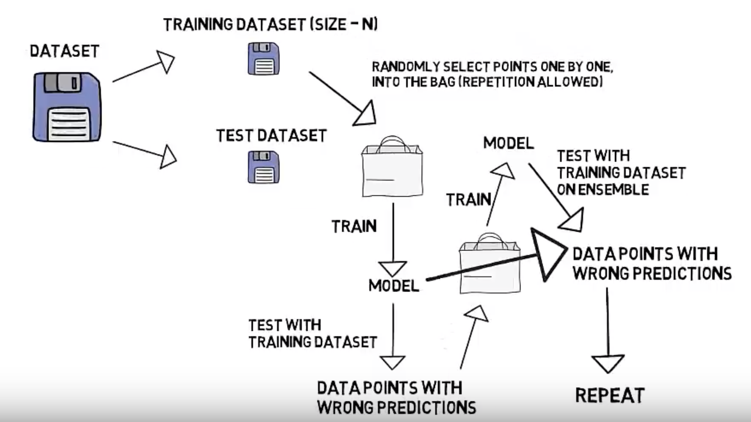
In Ensemble learning..
Bagging
- Random Forest
(Radomly choose feature)
Boosting
- AdaBoost(Update parameter)
- Gradient Boosting
(Using residual error)

Slide 7
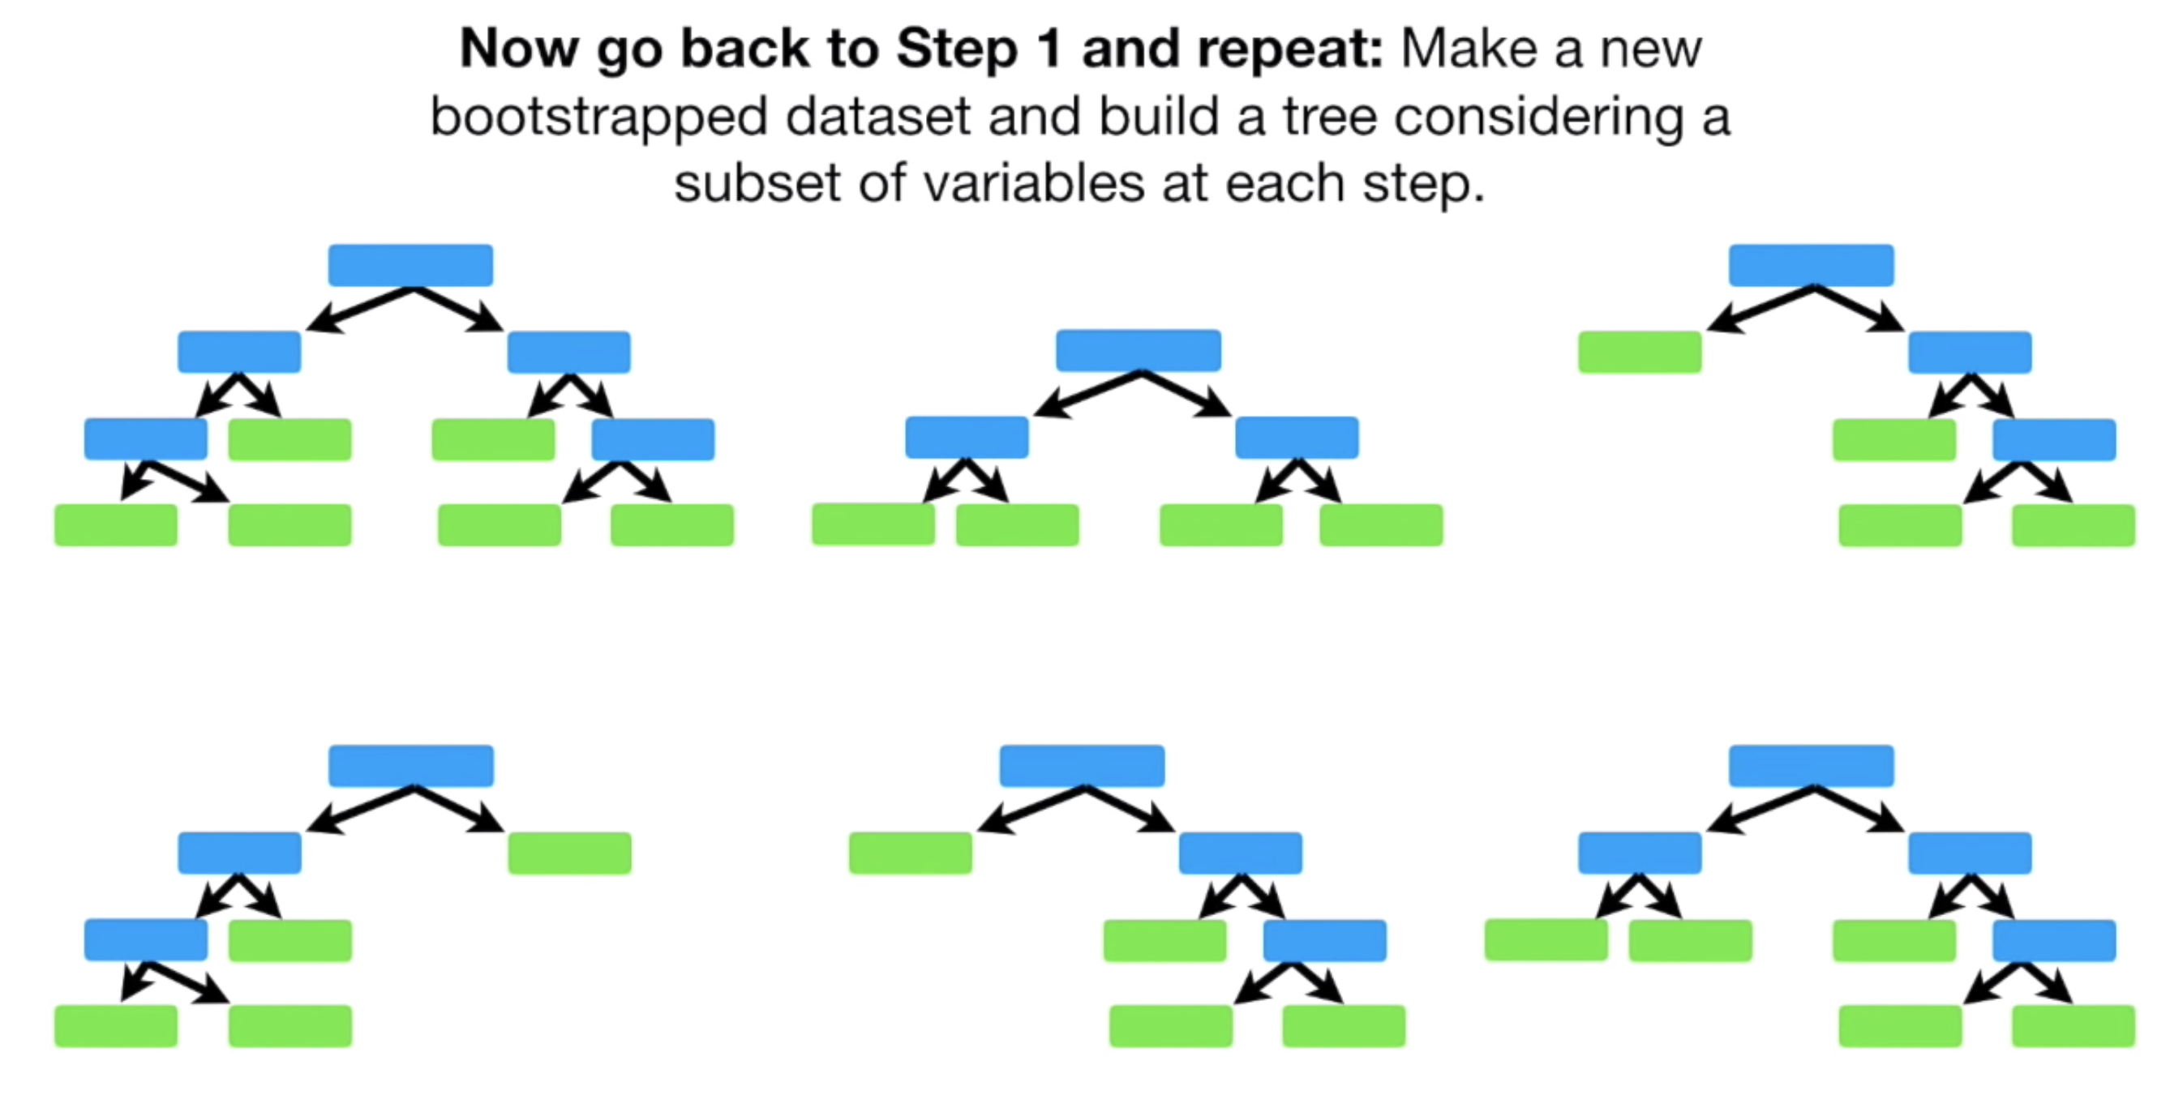
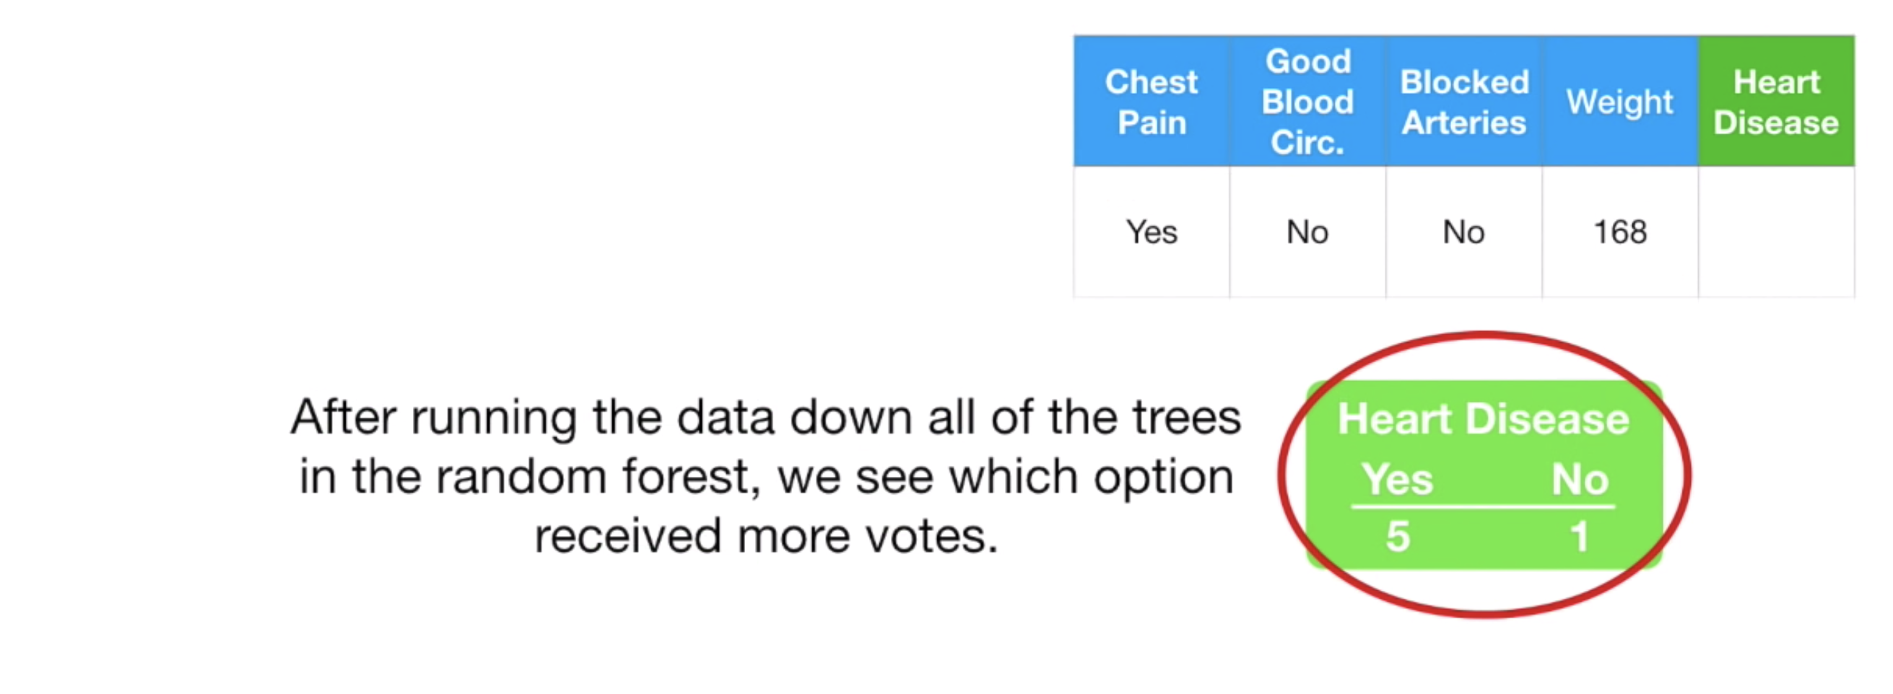
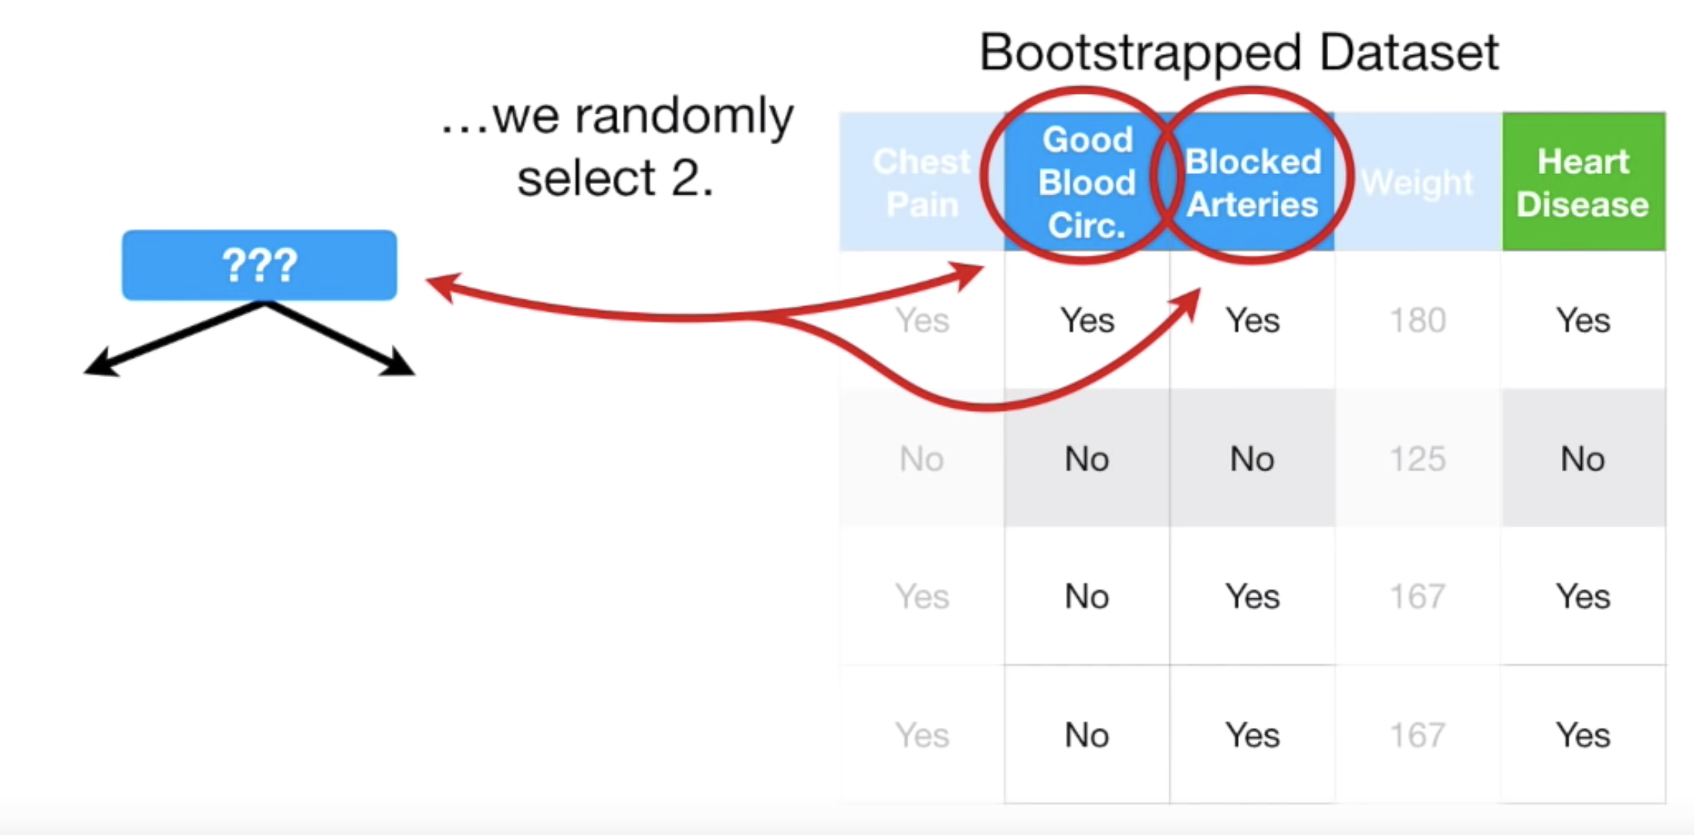
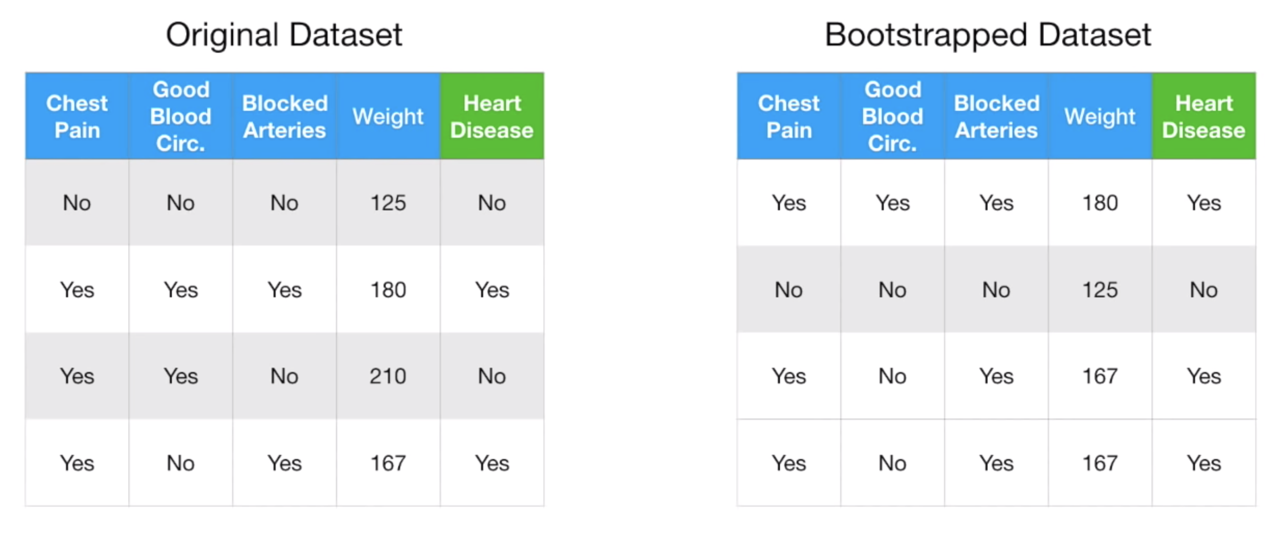
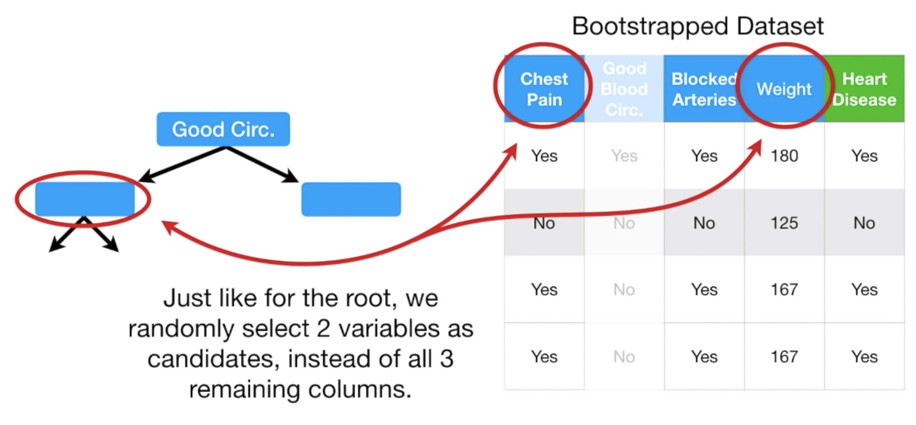
How Random Forest works?

Slide 8
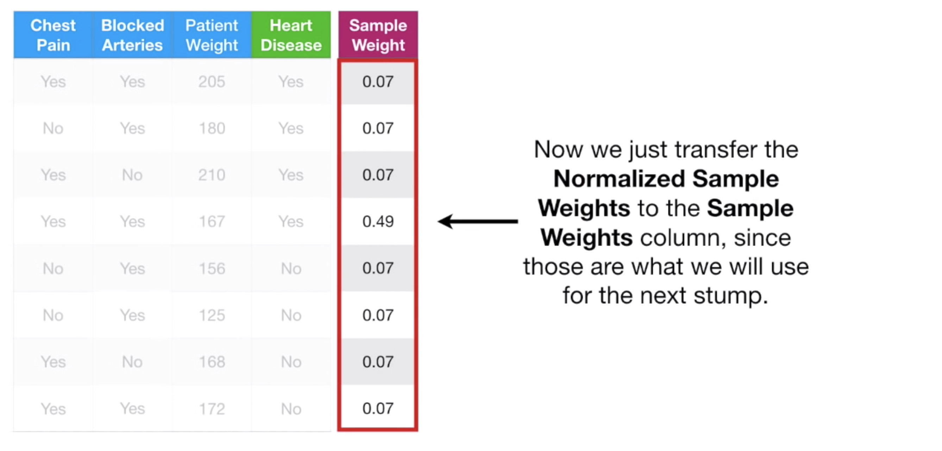
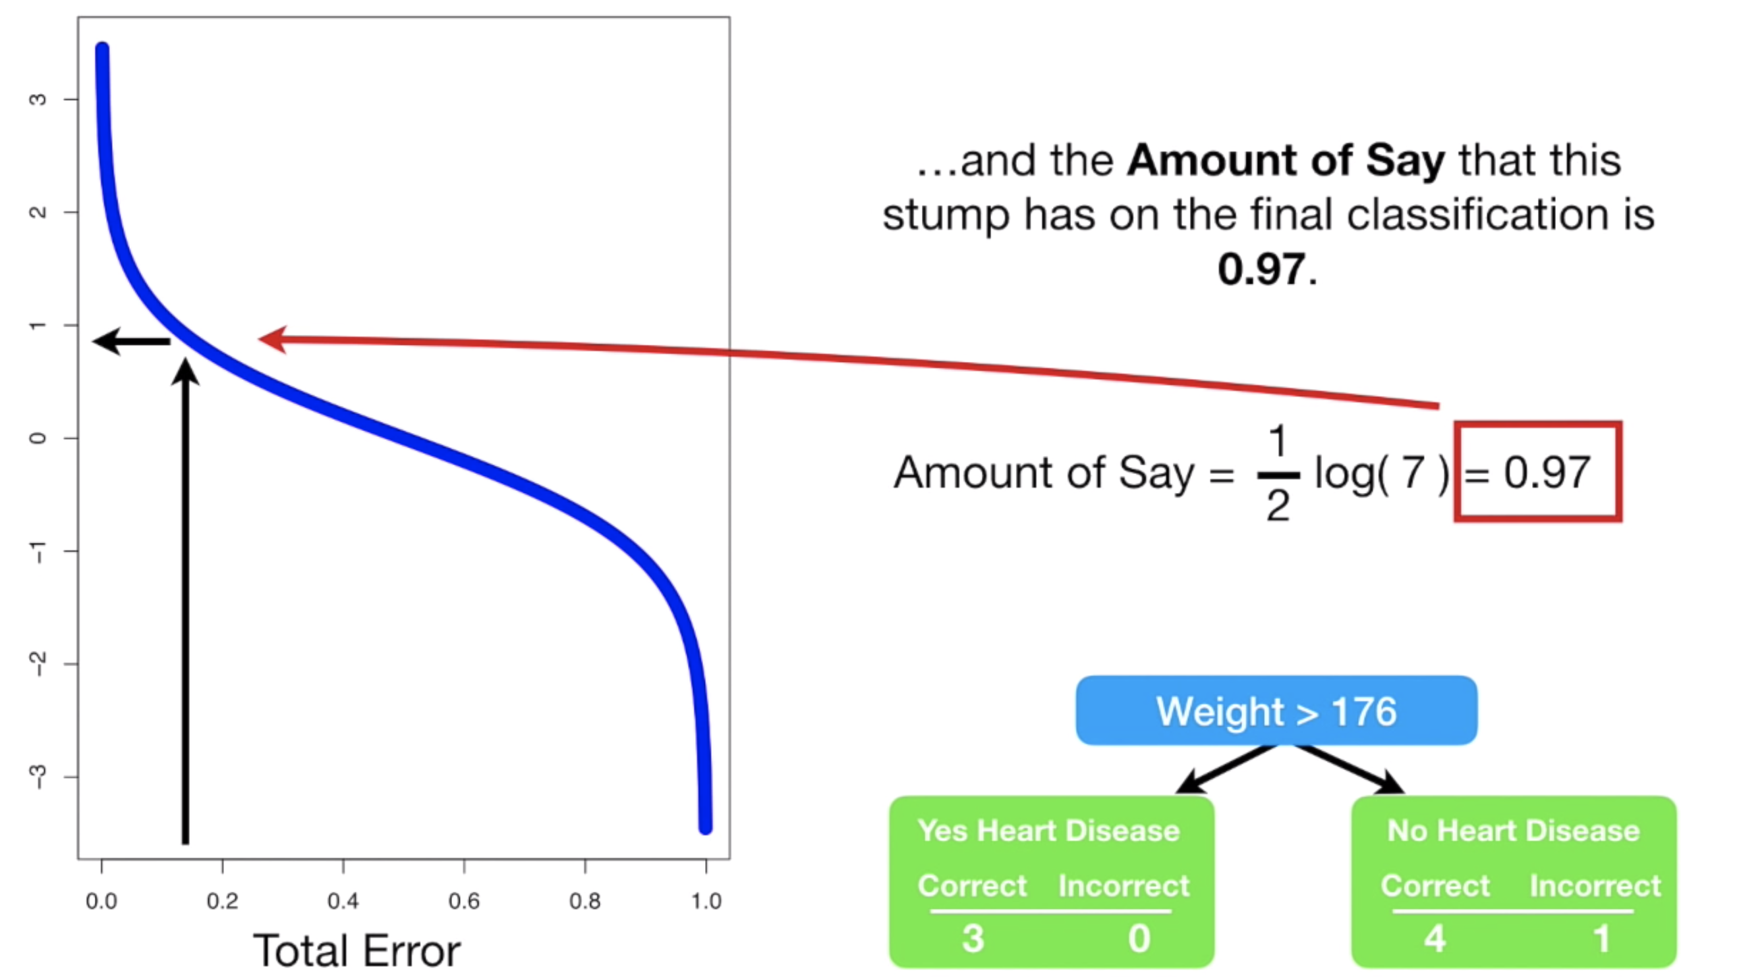
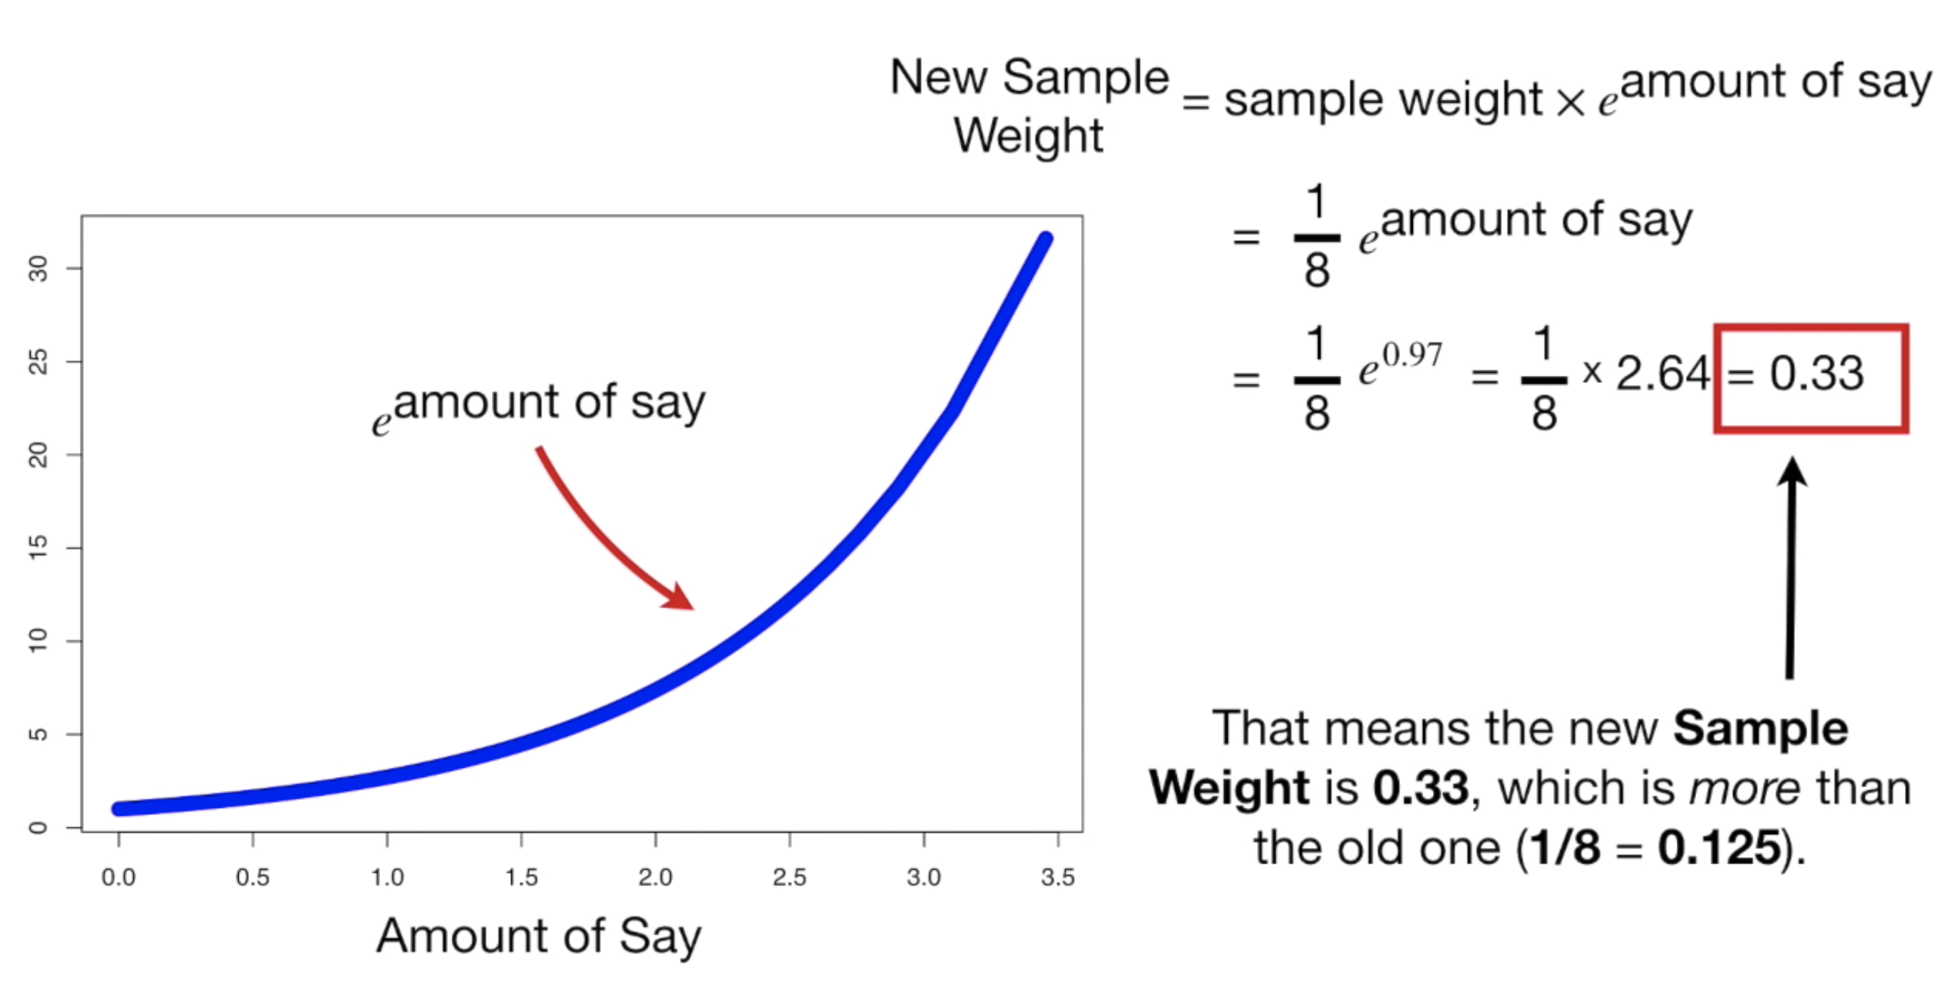
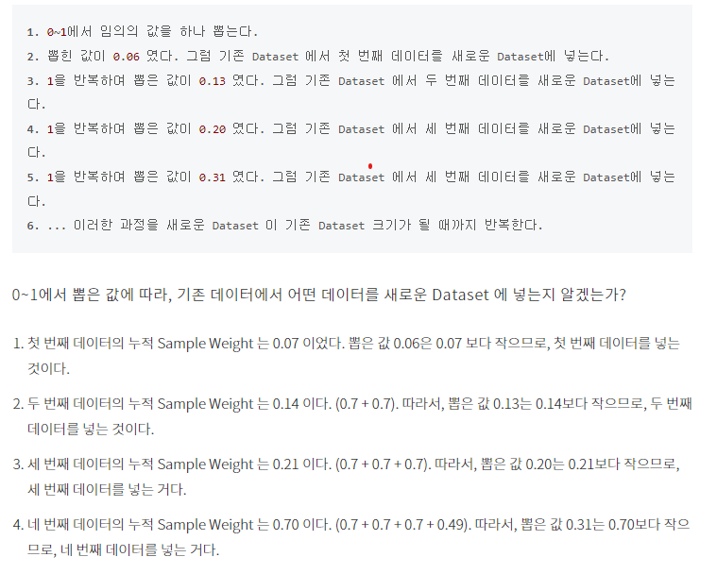
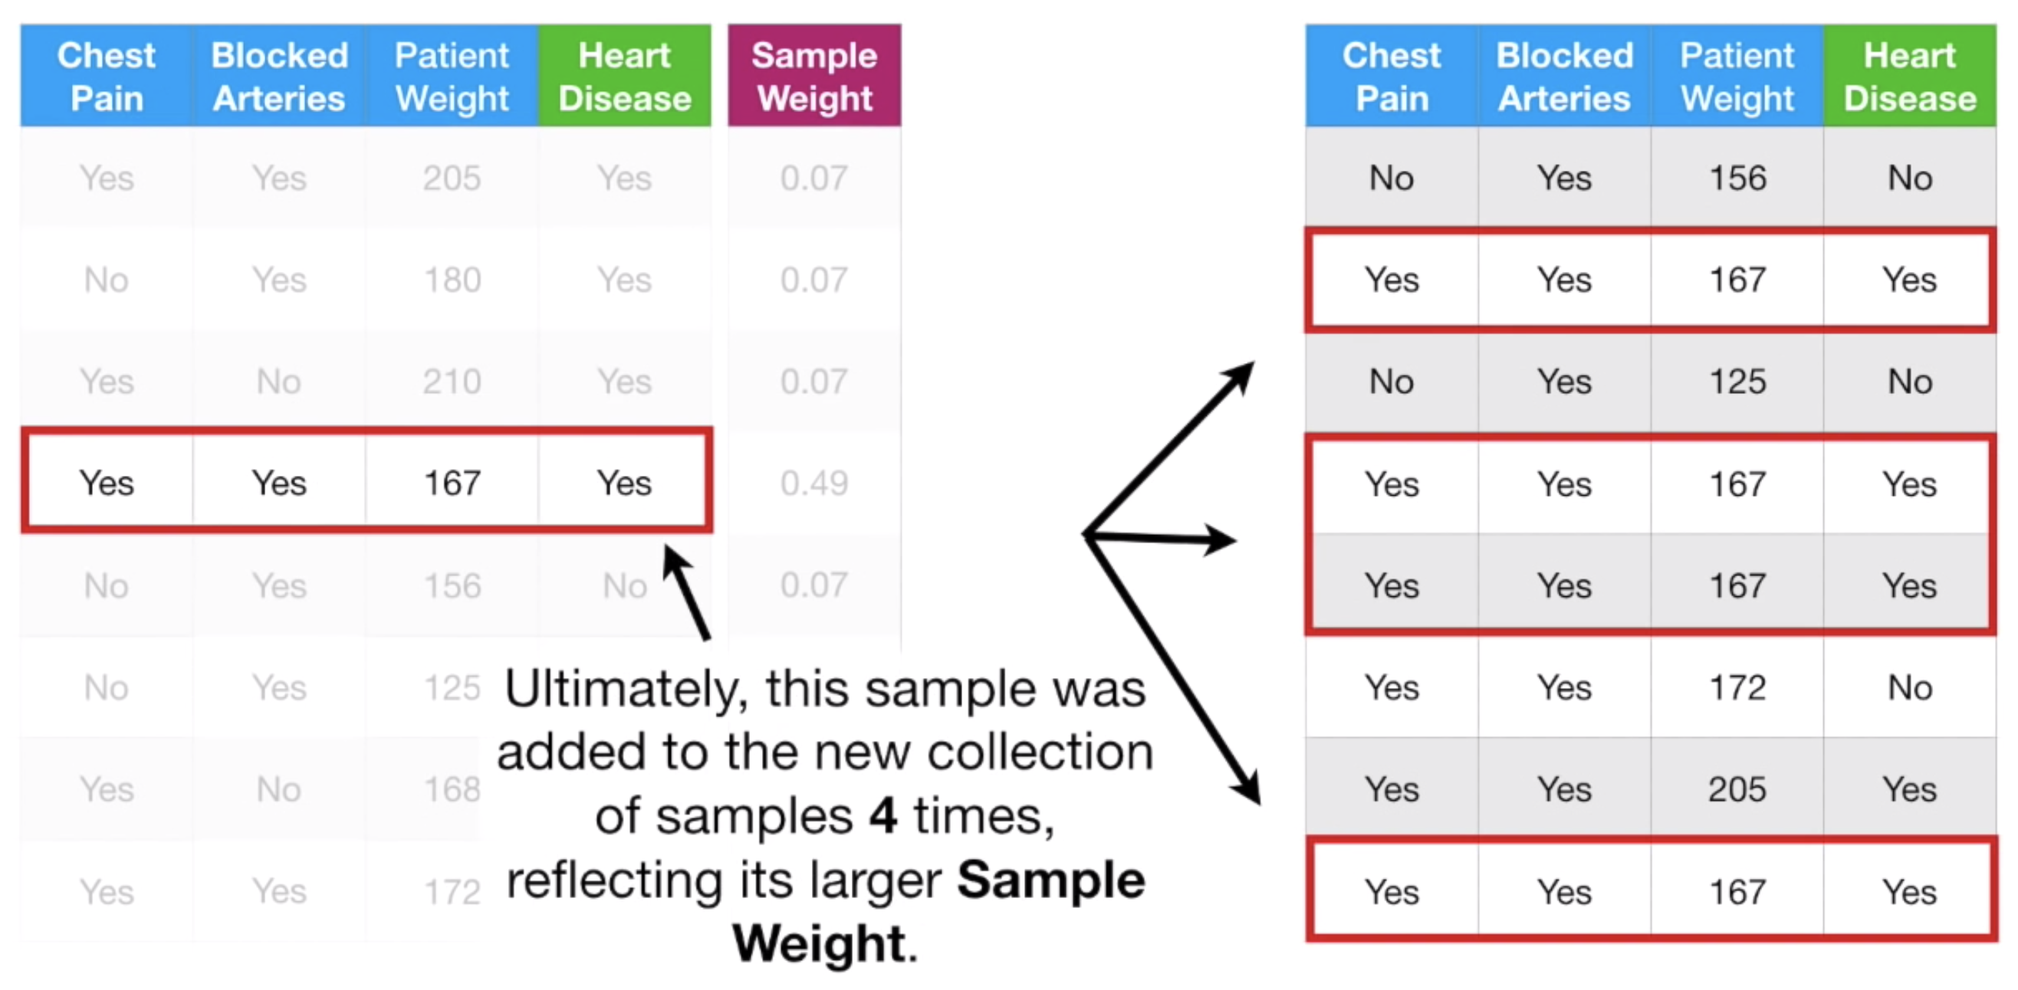
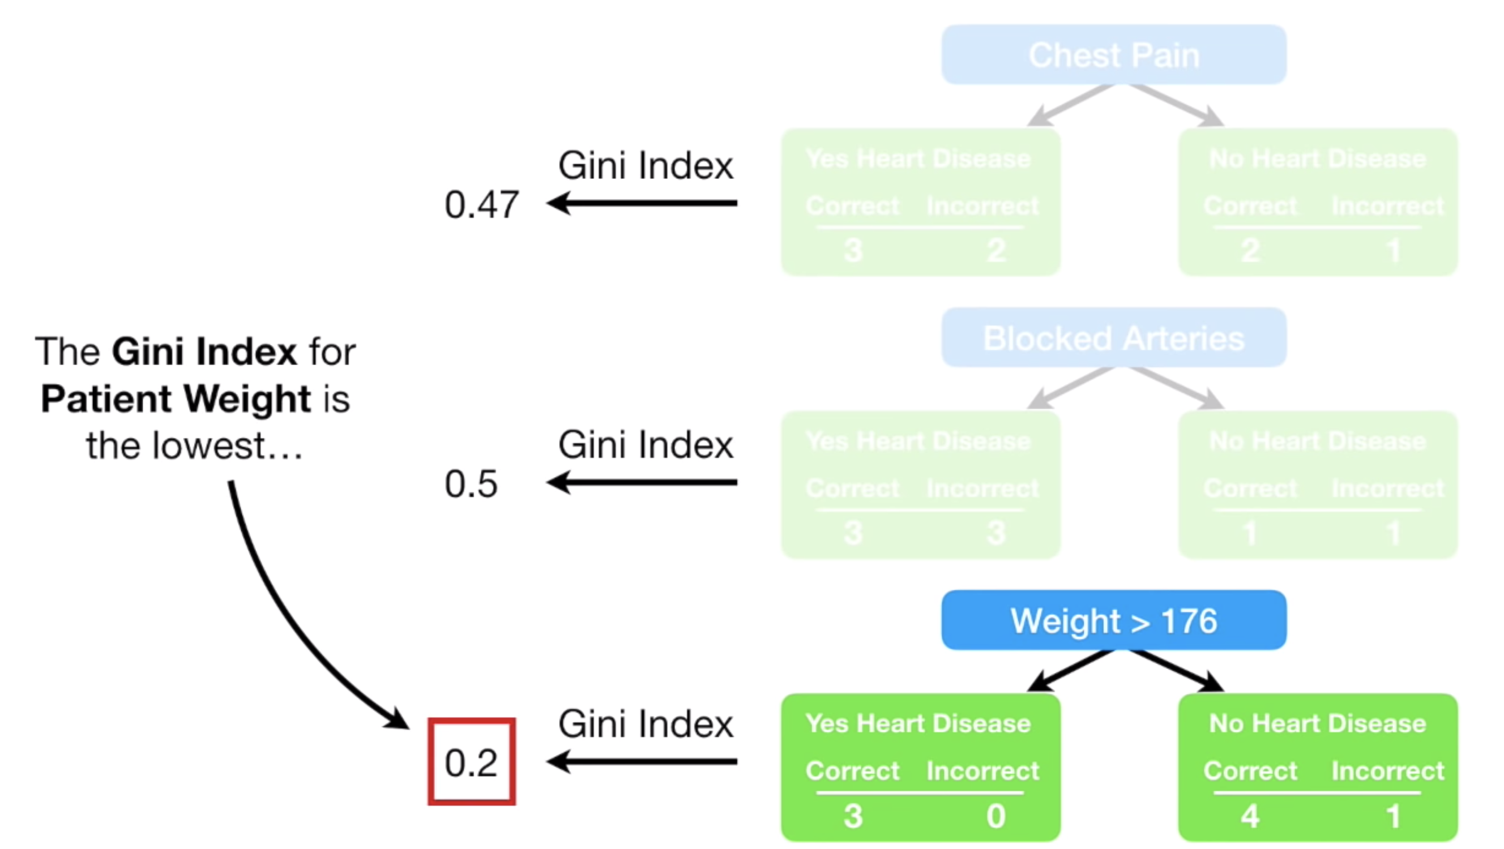
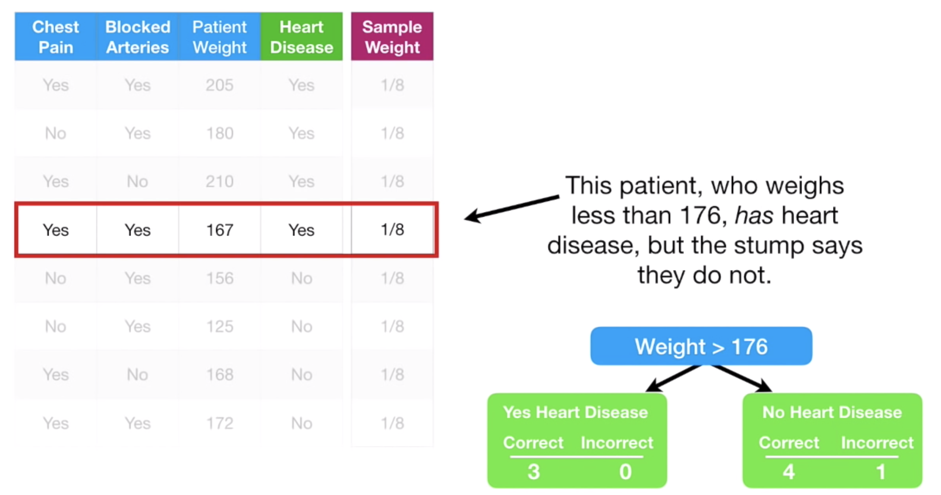
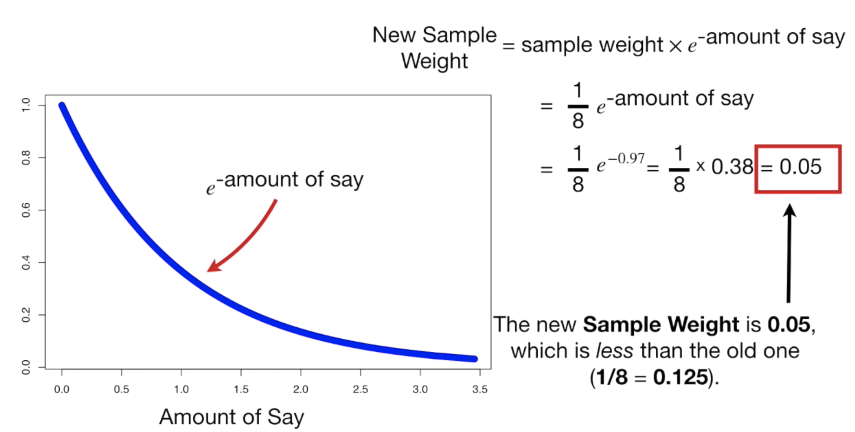
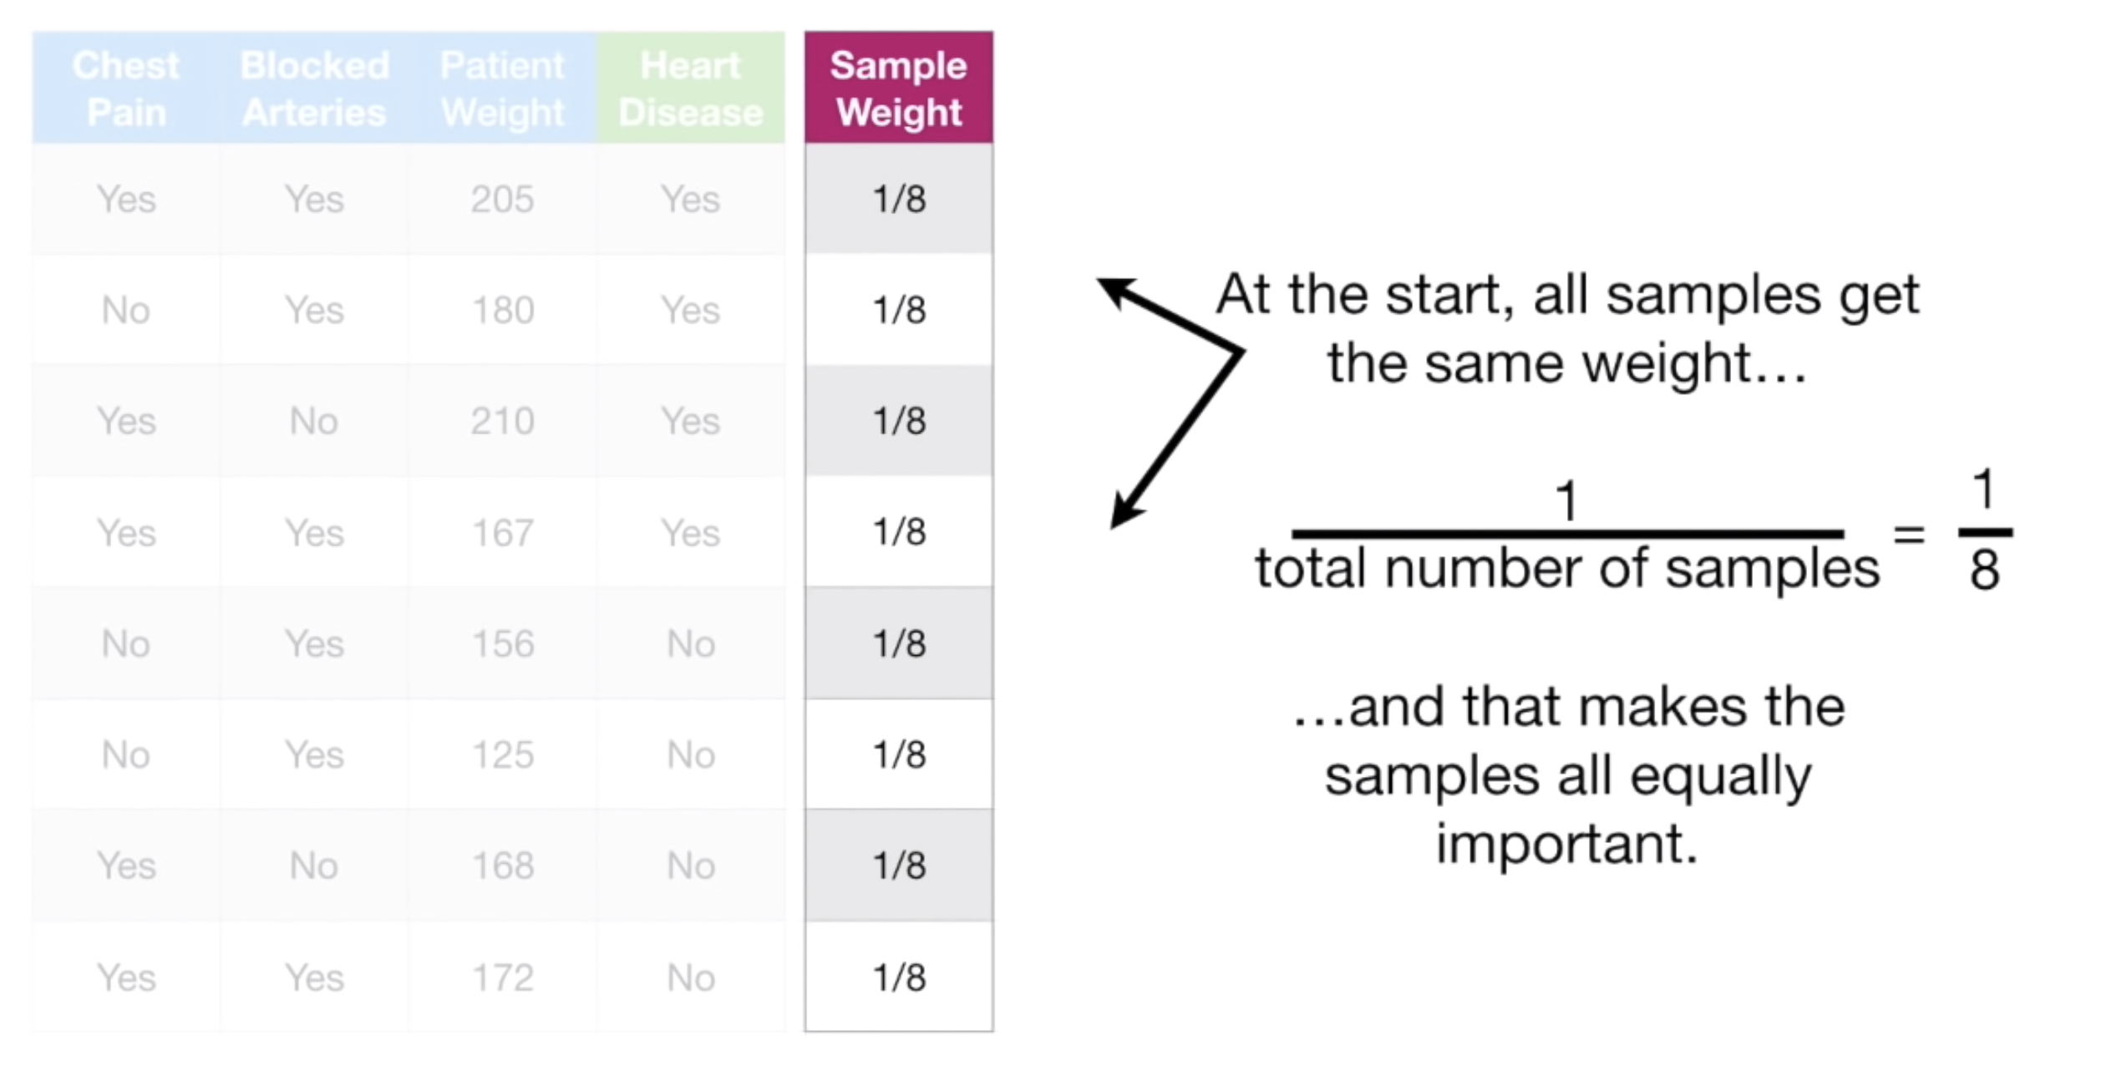
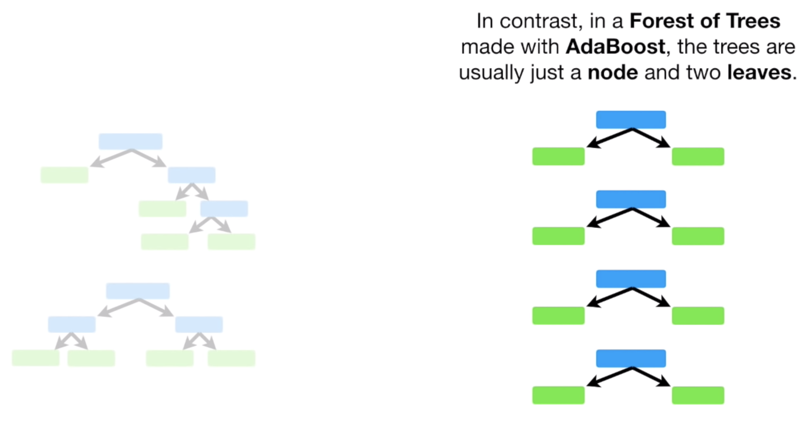
How AdaBoost works?

Slide 9
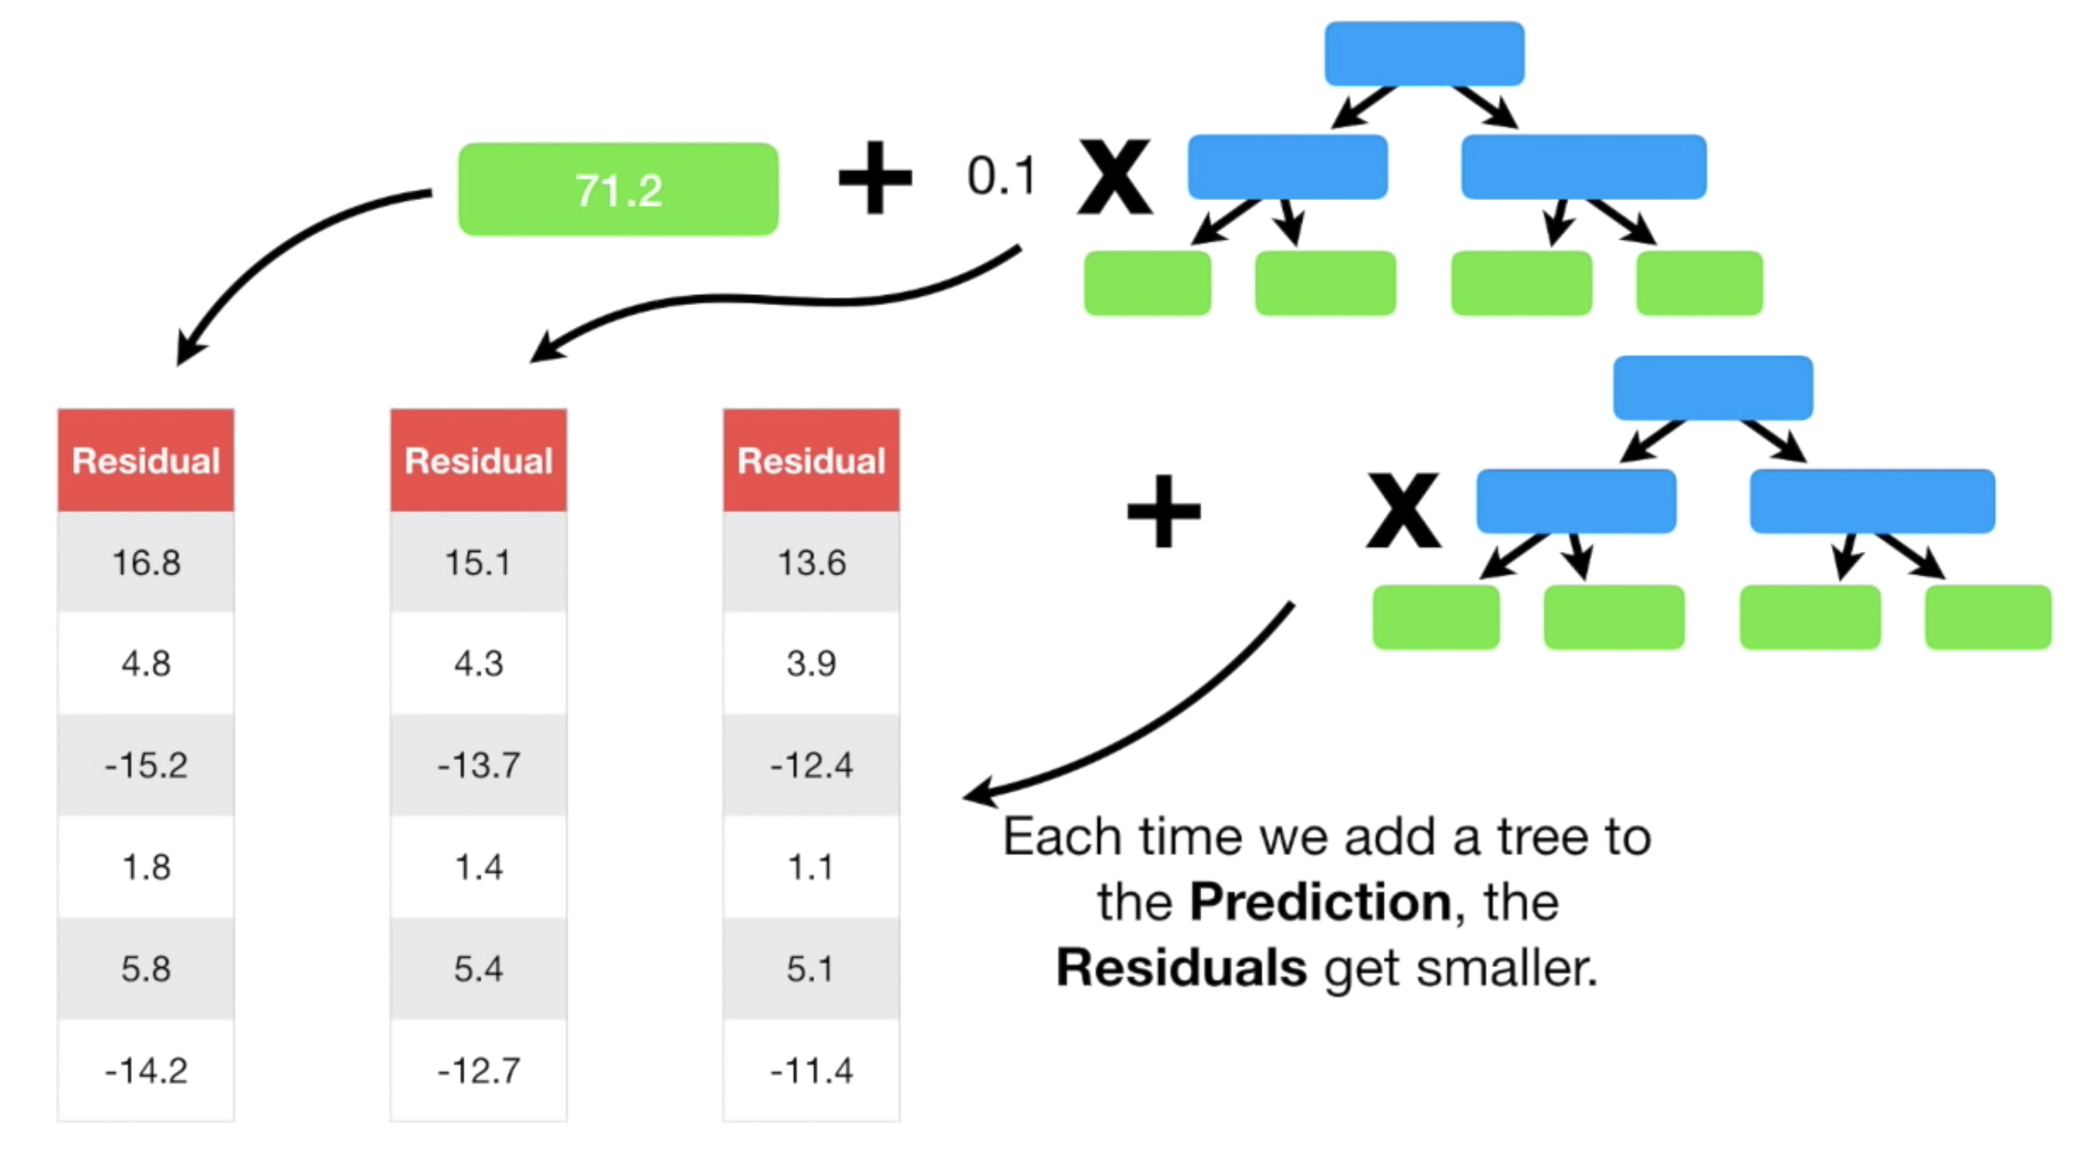
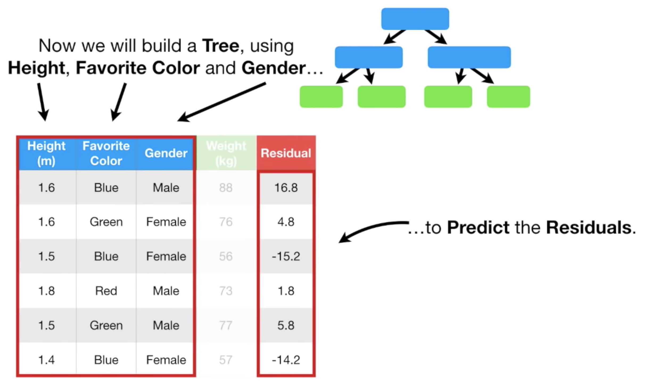
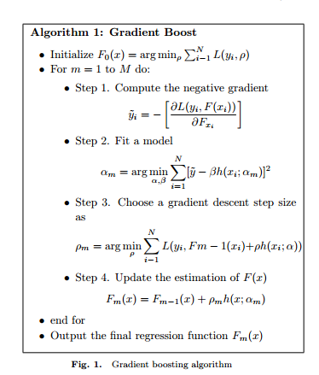
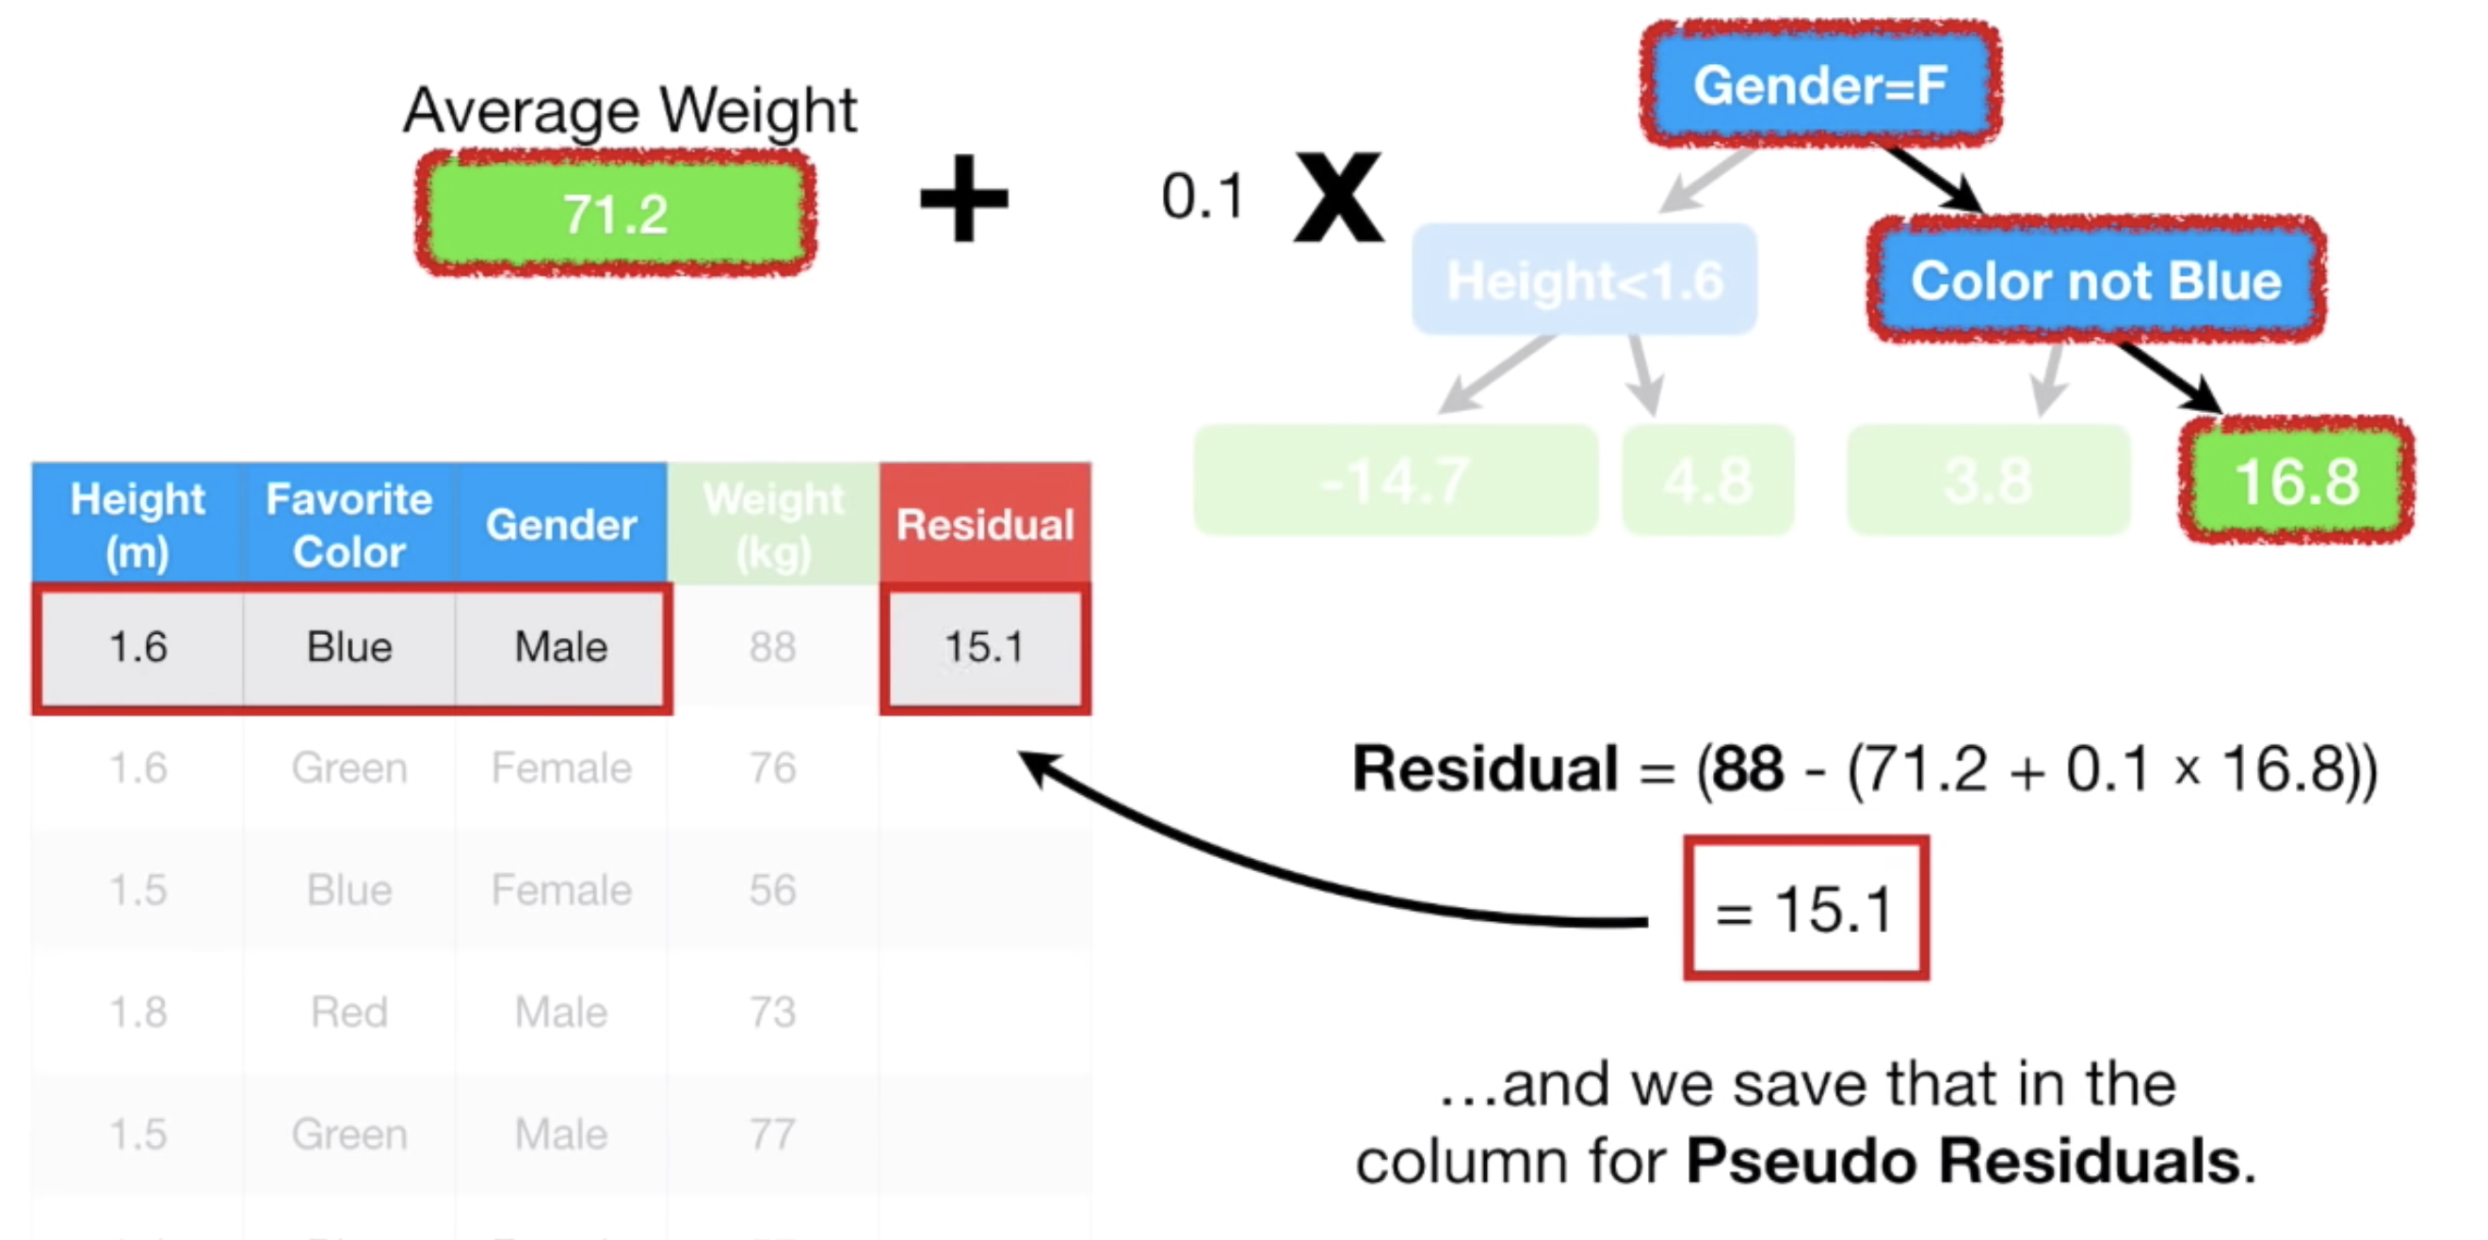
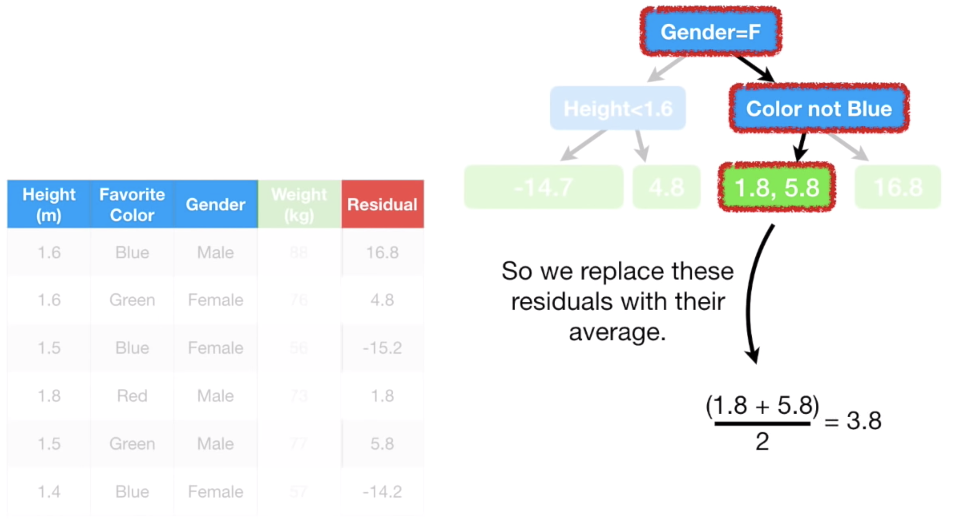
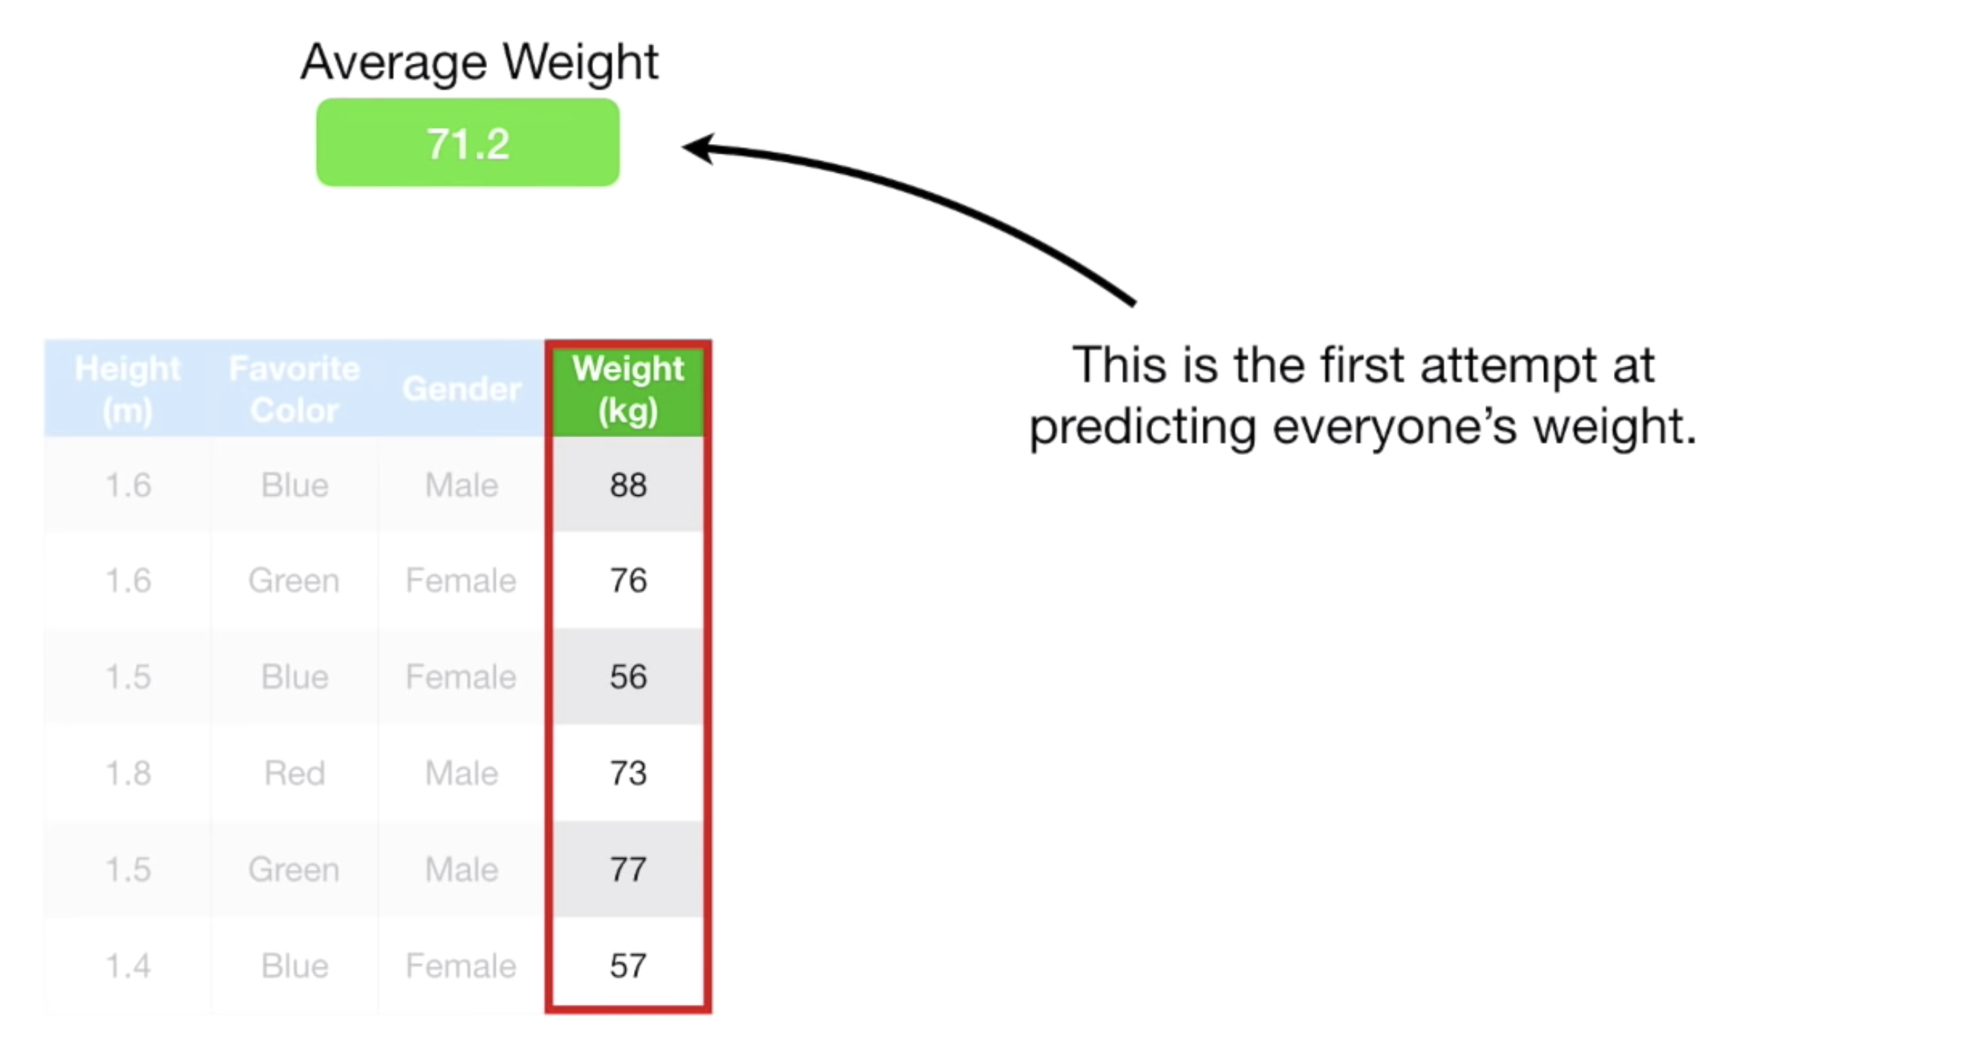
How Gradient boosting works?

Slide 10
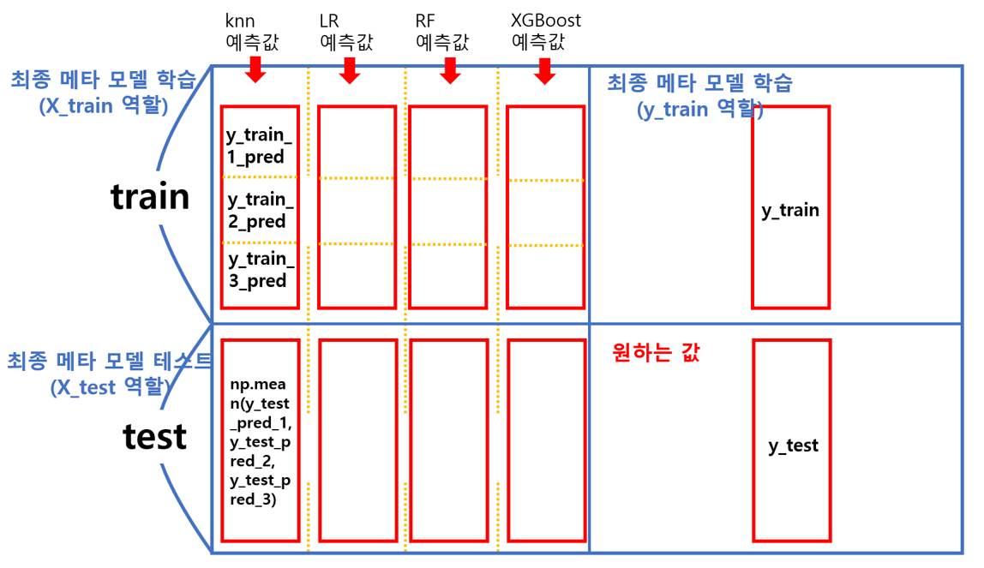
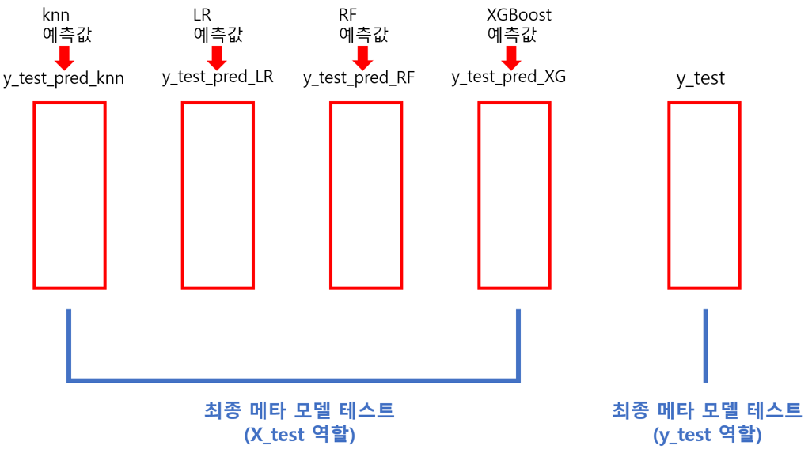
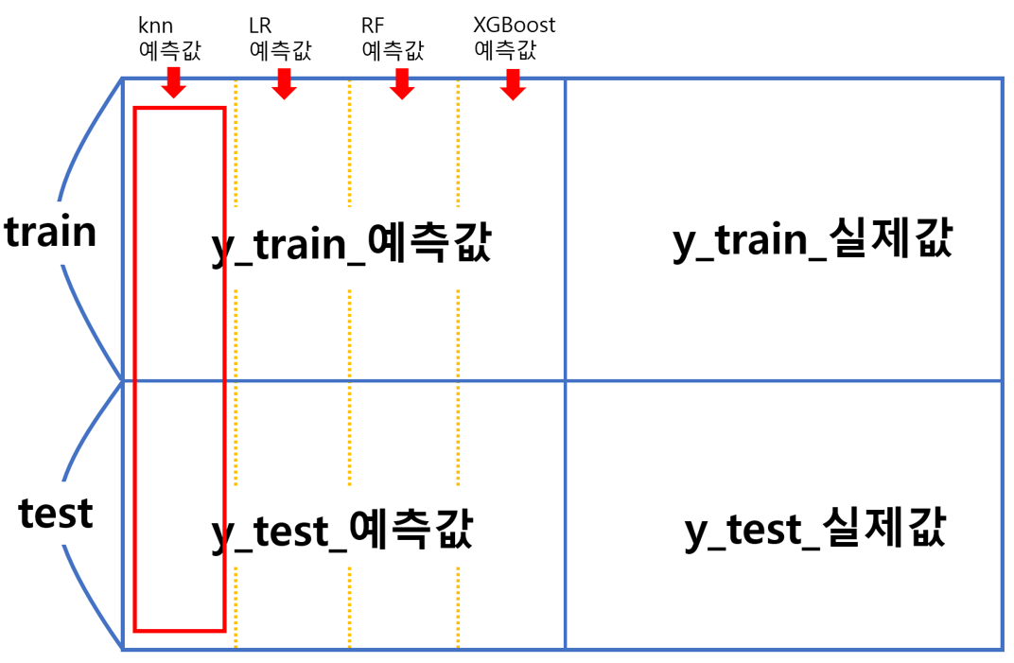
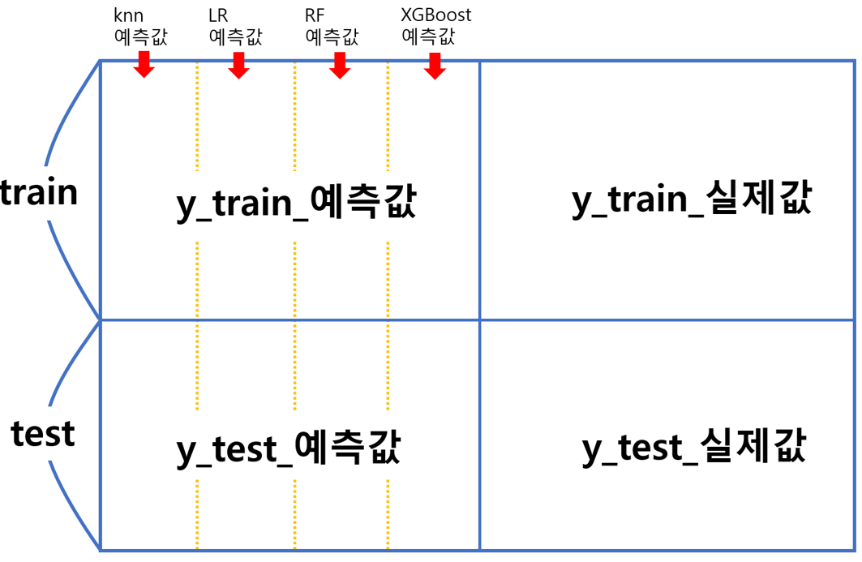
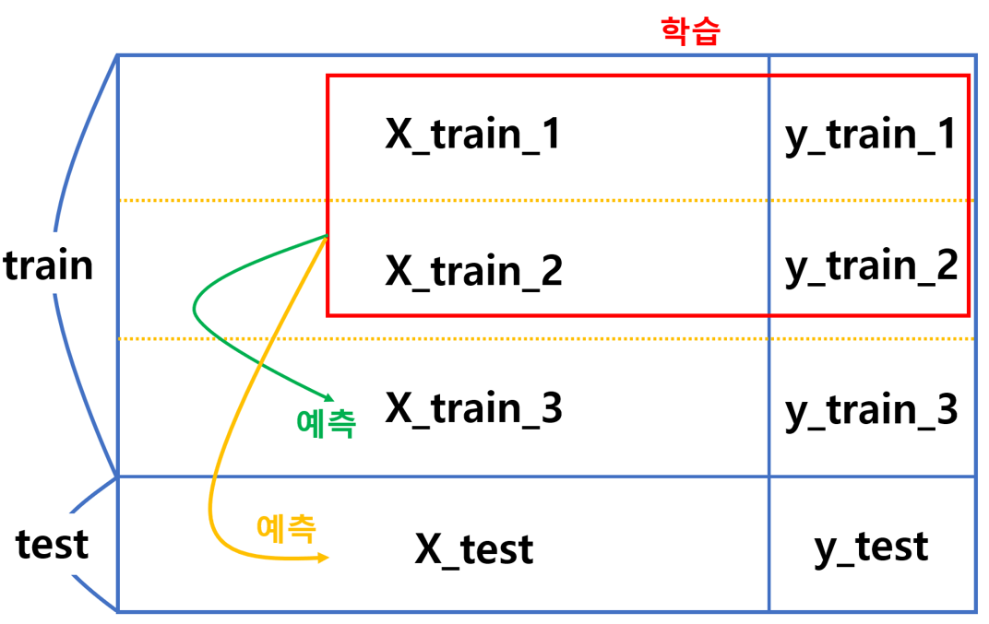
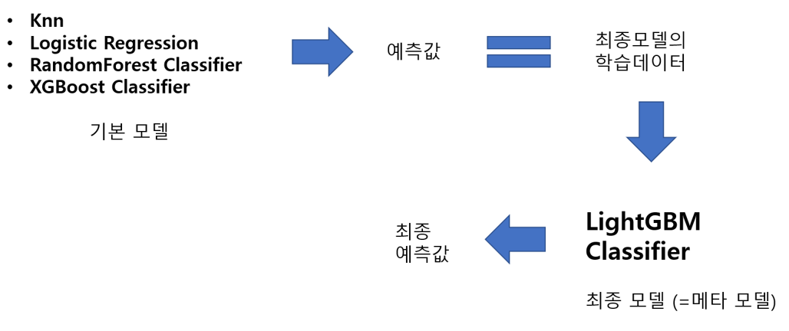
How Stacking works?

